Slide 1
Omao Disposable Cutlery
A Greener Lifestyle
EMSE 6035 Marketing Analytics for Design Decisions
Chi-Yun Chen, Laura Kadue, Weijie Pan and Vyshaaly Sivakumaar
Prof. John Paul Helveston
Dec 15, 2021

Slide 2




Team Presentation
Chi-Yun Chen Data Analytics
cychen9527@gwu.edu
Laura Kadue Engineering Management
kalypso@gwu.edu
Weijie Pan Systems Engineering
weijiepan93@gwu.edu
Vyshaaly Sivakumaar Engineering Management
vysaaly@gwu.edu

Slide 3
Table of Contents
Background
The Survey
Data Analysis
Survey Analysis Results
Conclusion
Q & A

Slide 4
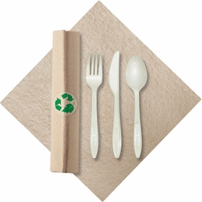
Why Disposable Cutlery?
Problem Single use plastics pollution
Solution Biodegradable disposable cutlery!
Market Size $2,696.4 million by 2028* in US
*Data Source: shorturl.at/kILMR
Notes:
Vyshaaly
https://www.globenewswire.com/en/news-release/2019/01/10/1686139/34408/en/Disposable-Cutlery-Market-to-Gain-a-Massive-Growth-US-2-696-4-Mn-by-2028-Future-Market-Insights.html

Slide 5
1. Background

Slide 6

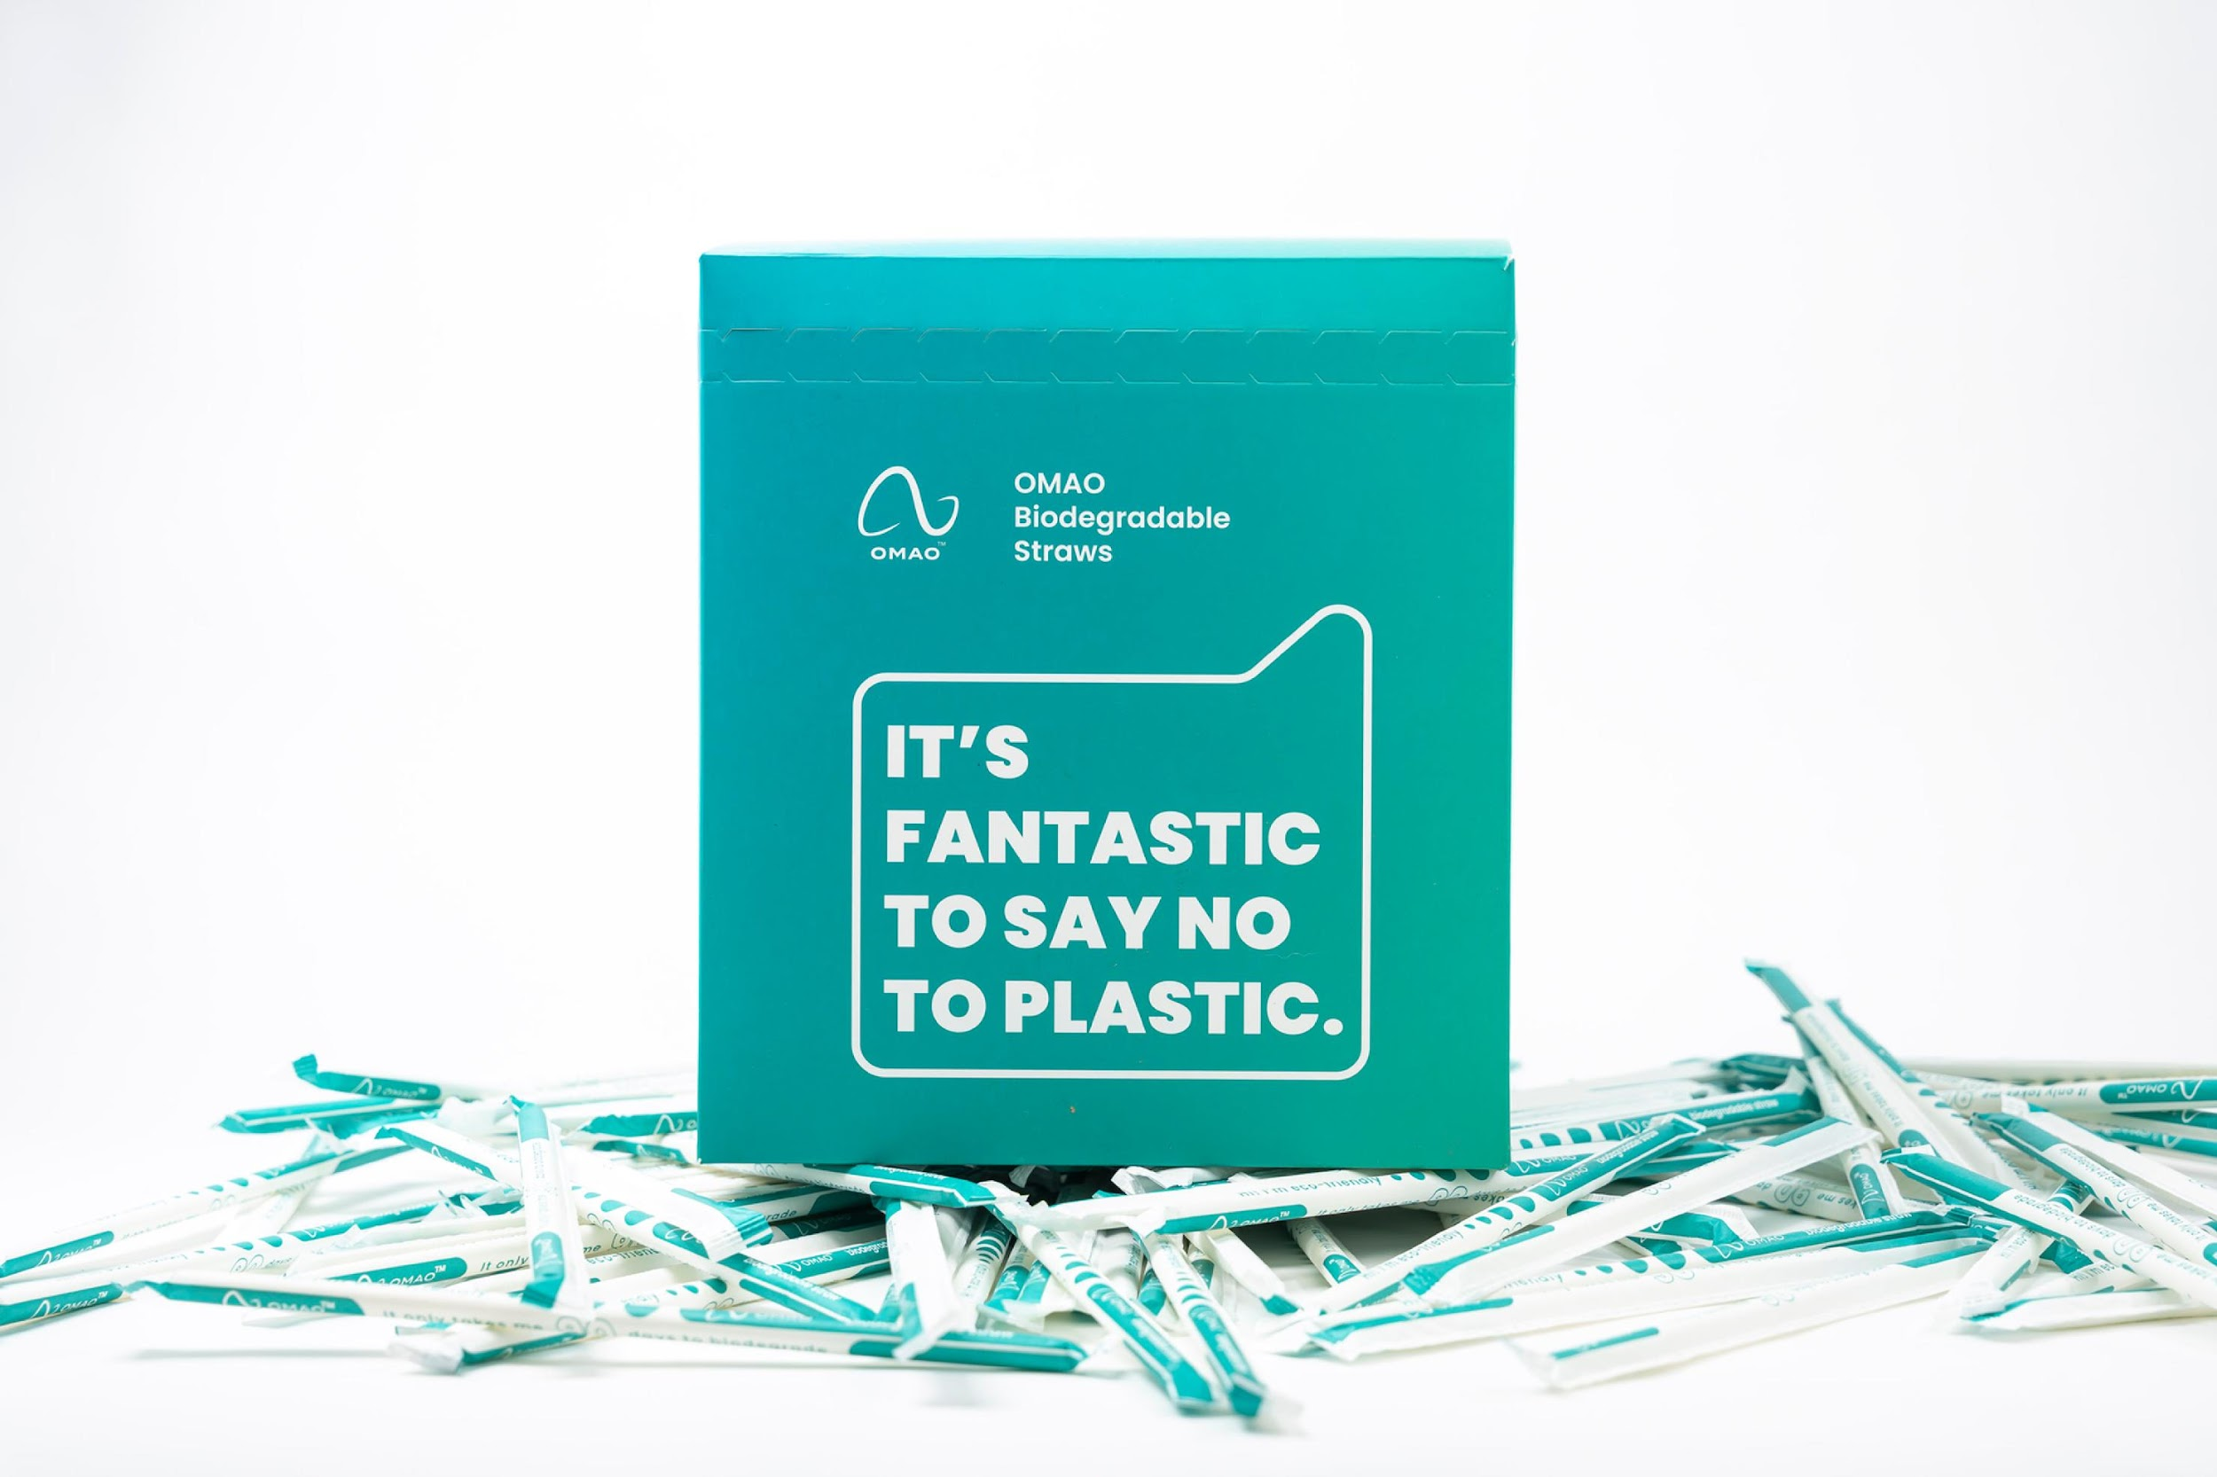
What is Omao?
Background New York City-based company.*
Focus Eco-Friendly products
Products Omao straws.
*Company Website: https://www.omaostraw.com/
Notes:
vyshaaly

Slide 7
2. The Survey
Product Attribute | Survey Plan | Choice Questions
Notes:
pan

Slide 8
Product Attributes
PRICE
Unit price varies based on different materials.
QUANTITY
Quantity varies for each product package plan.
P
Q
General plastic, Bamboo, Biodegradable.
MATERIAL
A fork only A fork and a knife A fork, a knife and a spoon
SET OPTIONS
M
S
Notes:
pan

Slide 9
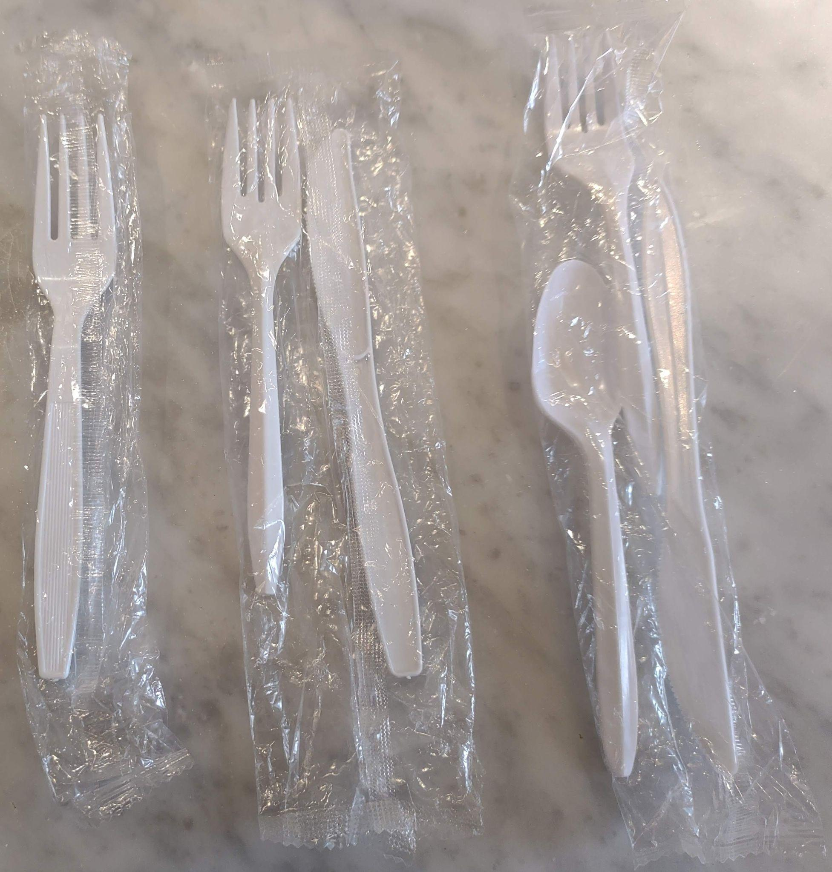
Set Options
F
FKS
FK
Notes:
pan

Slide 10
Eligibility Requirement
Age. Location. Consent.
Disposable cutlery use preference.
Disposable Cutlery
Survey
Background & Education
Omao Company,
Awareness of the plastic use situation,
Product attribute introduction.
Conjoint Survey Introduction
Survey introduction,
1 practice question.
Conjoint Questions
8 questions per survey,
3 options per question.
Respondent Information
Information collection for further analysis.
Notes:
Pan
Please include a mention of having the educational video

Slide 11
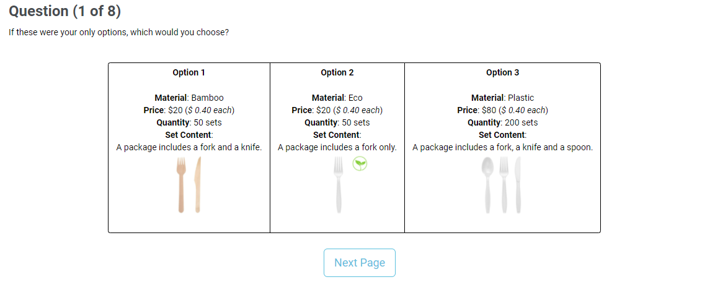
Choice Questions
Notes:
pan

Slide 12
3. Data Analysis
Data Cleaning | Demographic Analysis
Notes:
Laura

Slide 13
Demographic Analysis
330 Responses
251 Completed all Choice Questions
37 chose all the same answers
Total Time
Time on Each Choice Question
→ 201 Total Responses to Analyze
Notes:
Laura
Total Time - bottom 5th percentile, 11 dropped, >2.9 minutes
Time Each - 3 seconds, 2 dropped

Slide 14
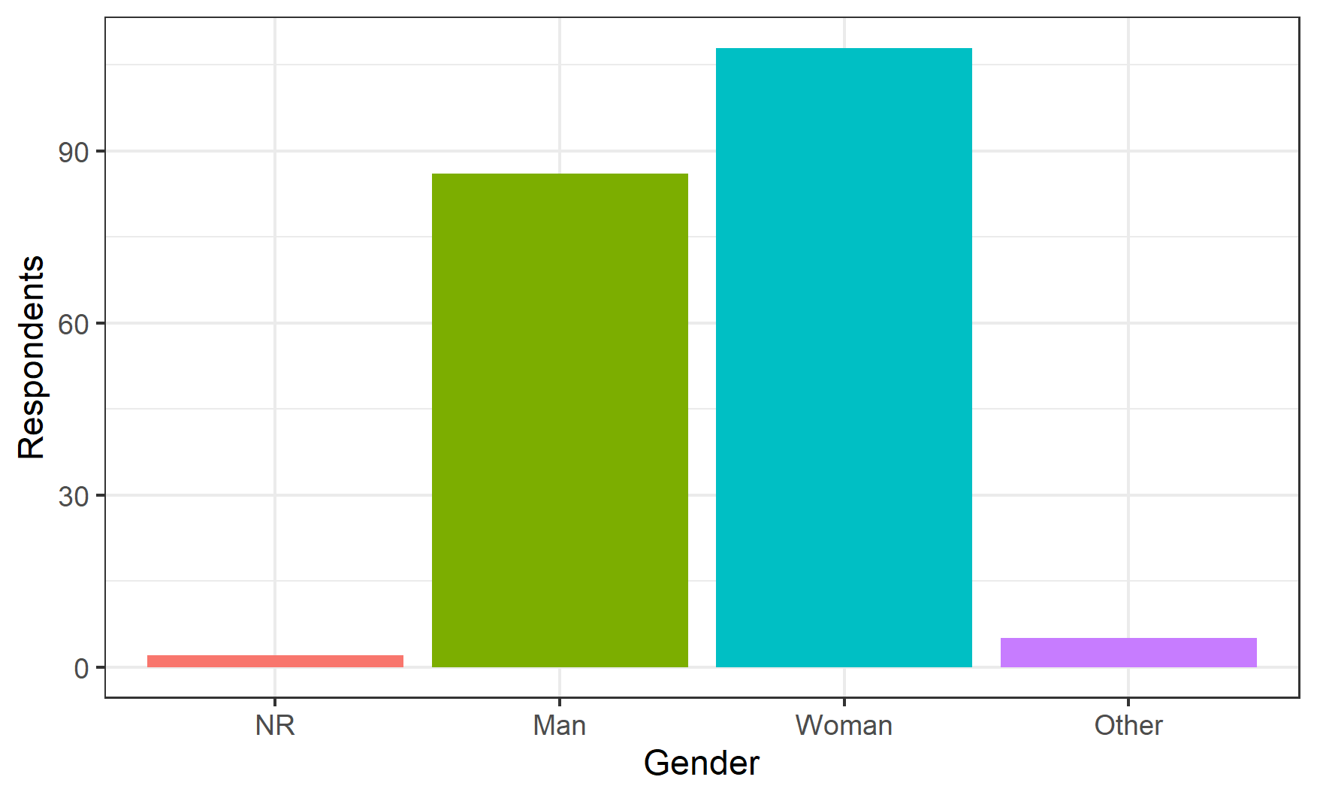
Women Lead in Gender
Notes:
Laura
Women - 53.7% Other - 5 people
NR - 2 people

Slide 15
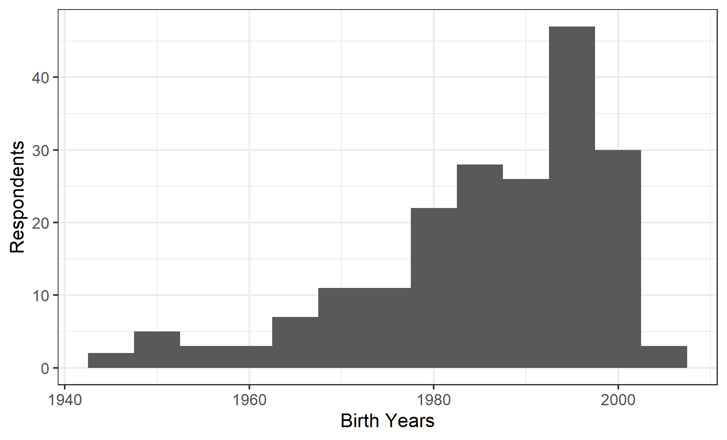
Under 30s Make Up Half of Responses
Notes:
Laura
Before 1990 - 49.8%

Slide 16
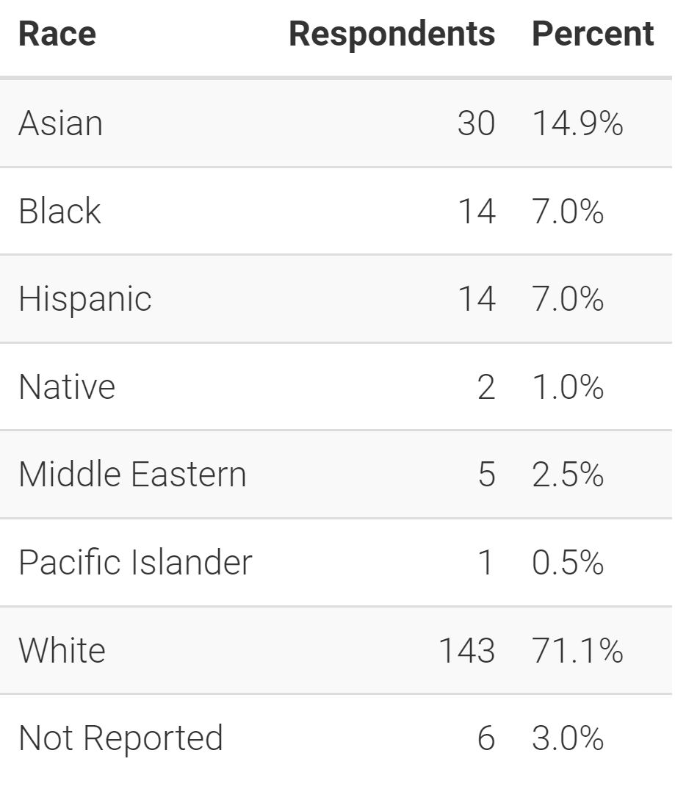
Race & Ethnicity
Notes:
Laura
13 people chose multiple races

Slide 17
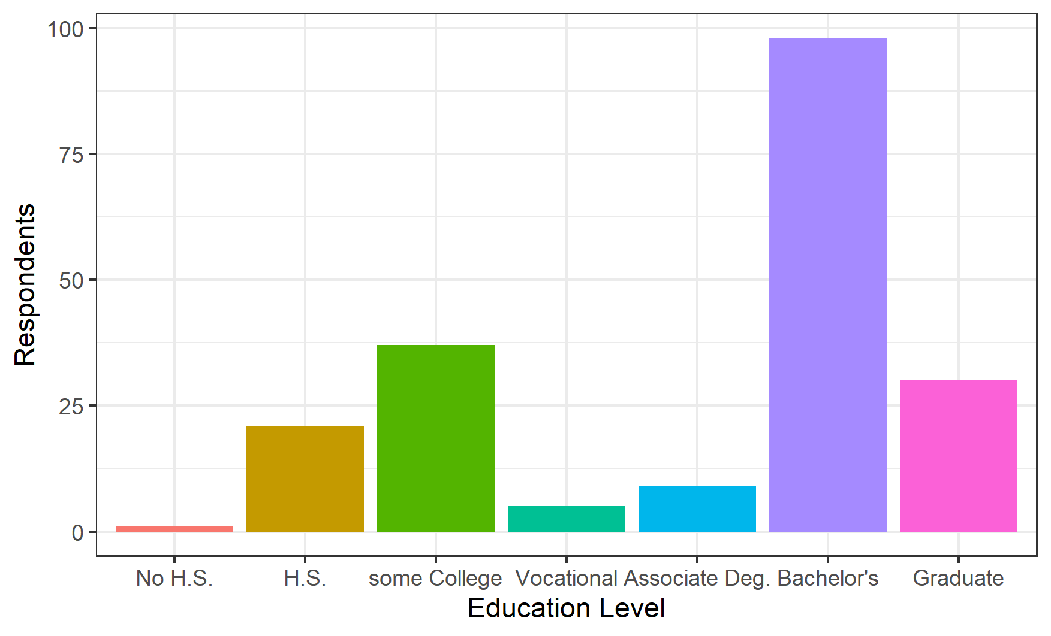
Education Leans Heavily into College
Notes:
Laura
Bachelor’s - 48.8%
Bachelor’s & Graduate - 63.7%

Slide 18
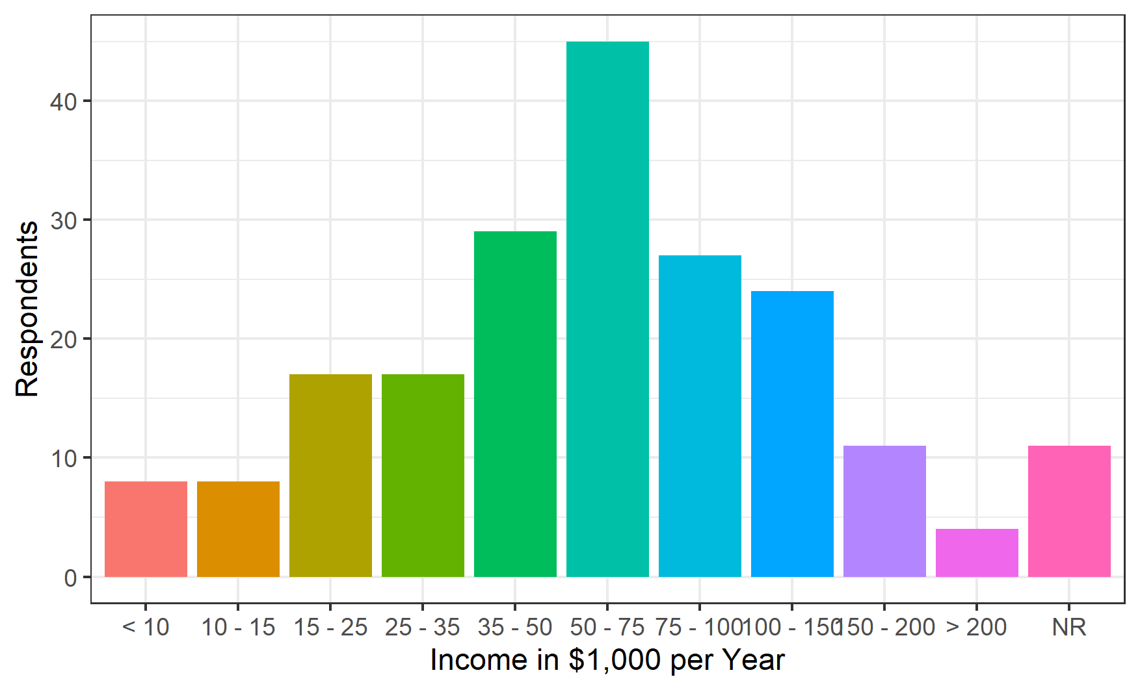
Income Normally Distributed
Notes:
Laura

Slide 19
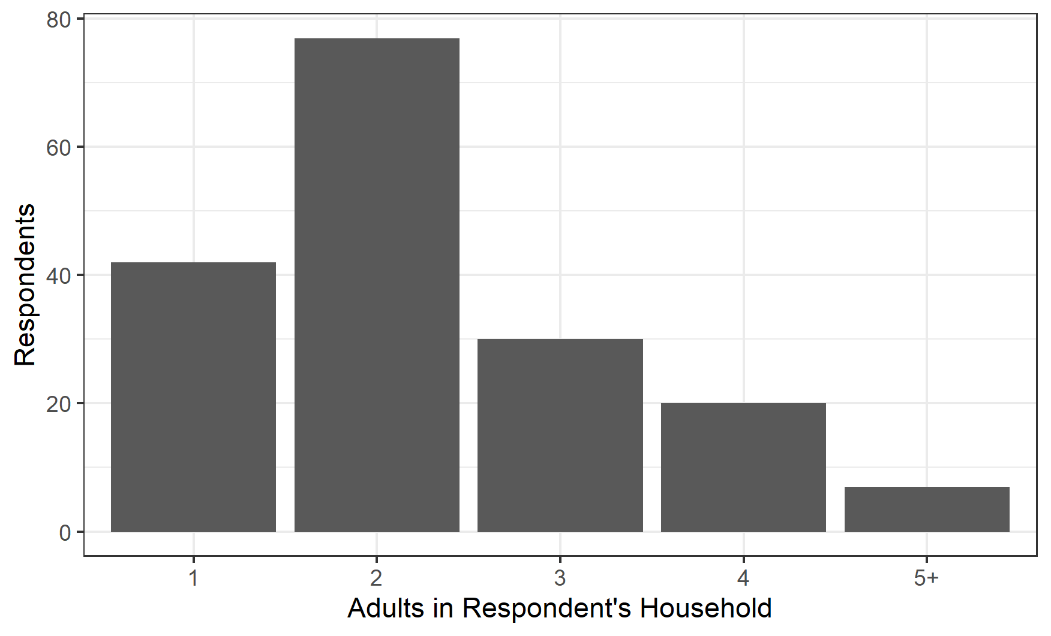
Households Tend to be Small
Notes:
Laura
1- and 2-person households - 67.6%
Max 8-person household
NAs - 25 people
Minors: NAs - 158 people

Slide 20
4. Survey Analysis Results
Model | Willingness To Pay | Sensitivity Analysis
Notes:
Yun

Slide 21
Model
Notes:
Vyshaaly

Slide 22
Model
Variable
set_price
quantity
material_Bamboo
material_Eco
setOptions_fk
setOptions_fks
Baseline
Material - Plastic
Set Options - Fork only
Notes:
Yun

Slide 23
Model
Model Equation
Coefficients | Value | Coefficients | Value
𝛽₁ | -0.09946 | 𝛽₄ | 1.50263
𝛽₂ | -0.00009 | 𝛽₅ | 0.14318
𝛽₃ | 1.17743 | 𝛽₆ | 0.14826
Notes:
Yun

Slide 24
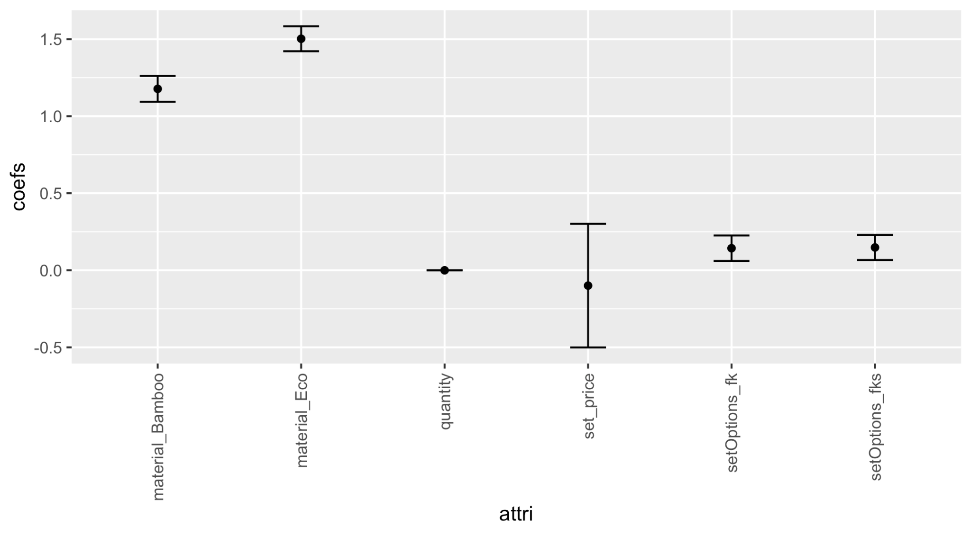
Model
Coefficients
Notes:
Yun

Slide 25
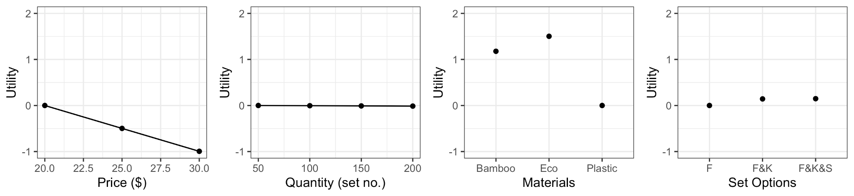
Model
Utility of Attribute
Notes:
Yun

Slide 26
Willingness To Pay
Notes:
Vyshaaly

Slide 27
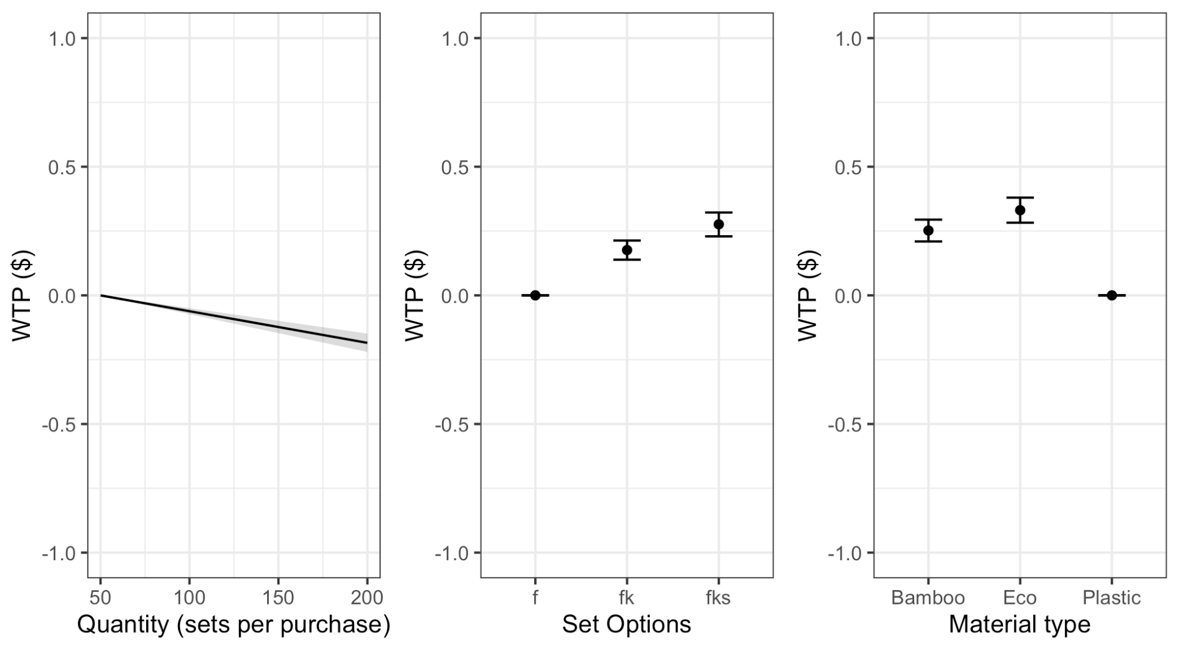
Eco And FKS Set Fetch Highest Prices
$0.28
$0.33
Notes:
Vyshaaly

Slide 28
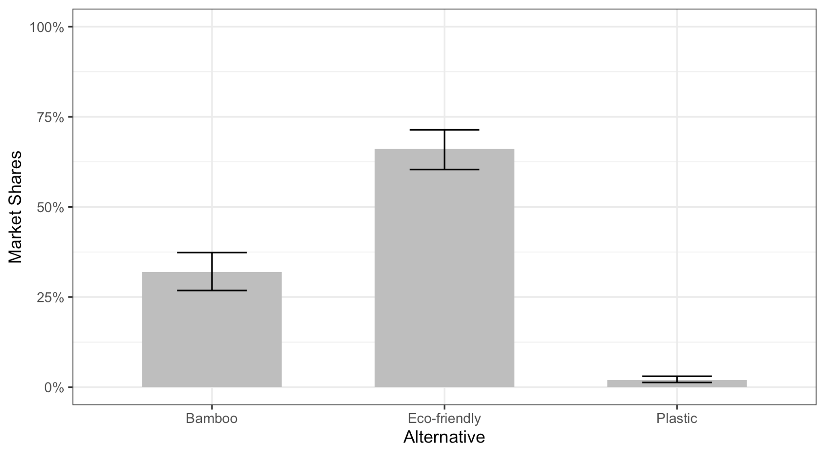
Eco Holds Highest Market Share
66%
32%
2%
Notes:
Vyshaaly

Slide 29
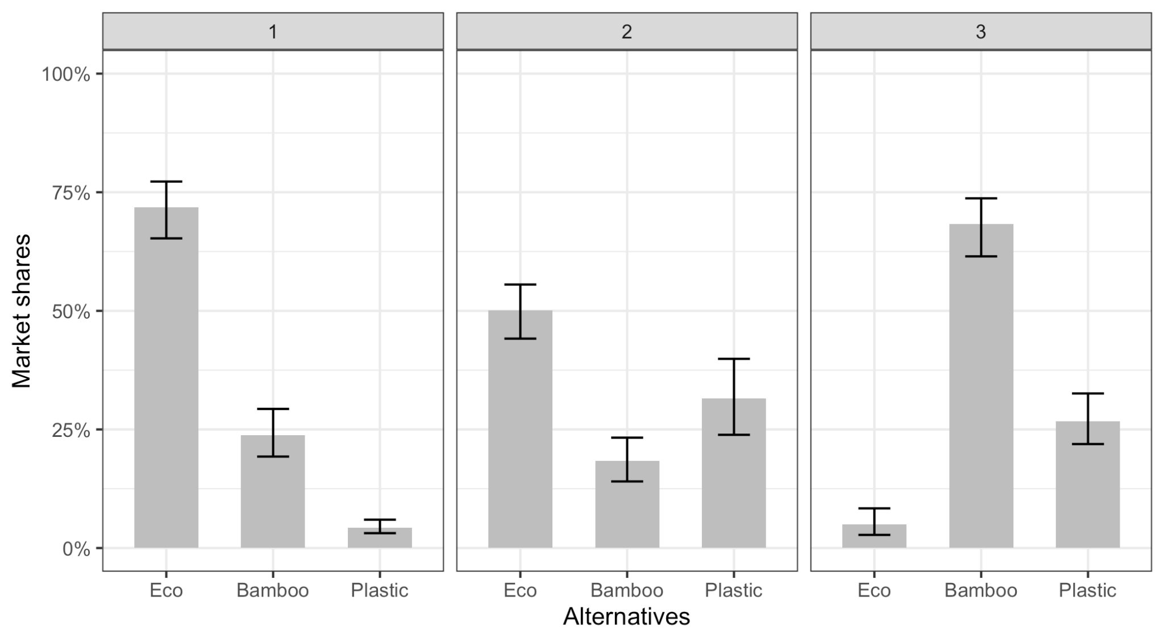
Eco Captures An Average Market Share Of 45%
72%
68%
50%
31%
26%
23%
18%
4%
5%
Notes:
Vyshaaly
eco= 72, 50, 5 = 45
bamb= 23, 18, 68= 35
plast= 4, 31, 26 = 20

Slide 30
Sensitivity Analysis
Notes:
Pan

Slide 31
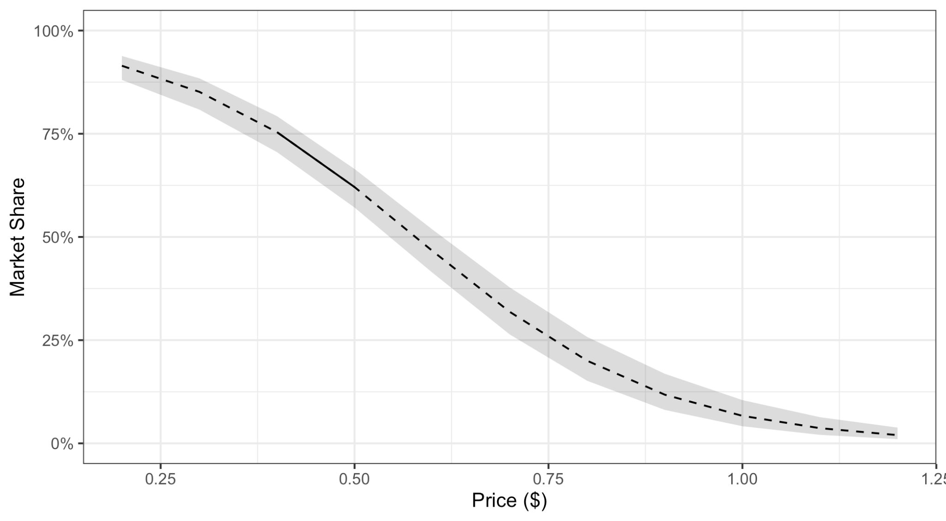
Market Share Drops As Price Increases
62%
50%
Notes:
pan
drop in market shares with increase in price. Price for at least 50% market share $0.5 (62%) - $0.6 (47%) per set

Slide 32
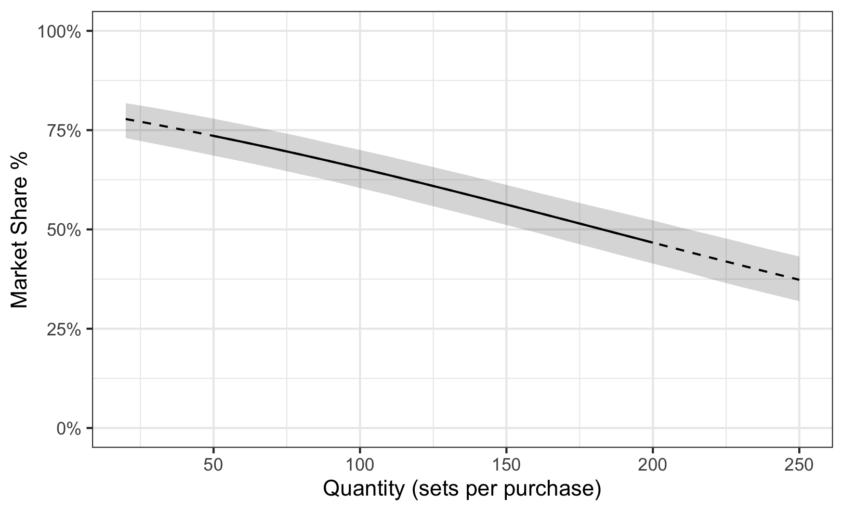
Market Share Drops As Quantity Increases
50%
Notes:
Pan
At 50% market share the quantity will be 180 sets per purchase

Slide 33
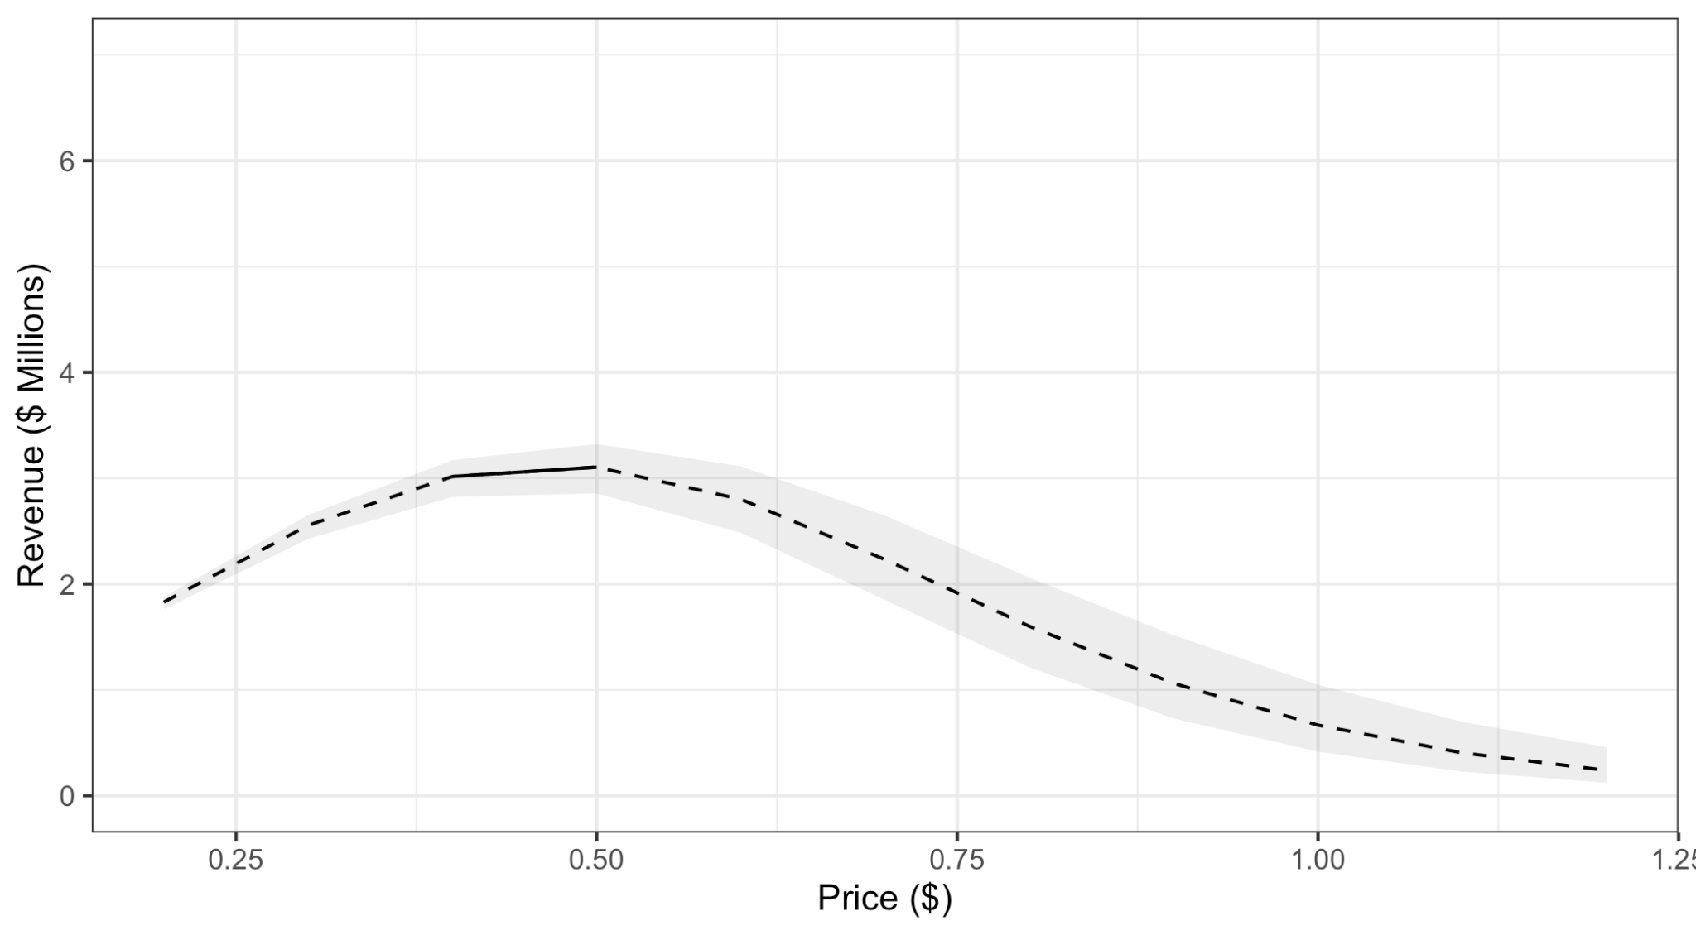
A Set Price Of $0.5 Per Set Maximizes Profit
Market size = 10 Mn units
Notes:
pan
Units= 10000000 max revenue. at Inflection point $0.5- 3.2 million, at $0.6 revenue drops to 3Mn

Slide 34
5. CONCLUSION
Cost Estimation | Suggestions
Notes:
Yun

Slide 35
Cost Estimation
Material: $2.00-$2.60 per pound.
Weight of Plastic Spoon: 2.20 grams.
50 FKS material cost: $1.95
Labor cost: 4X of material
→ Total Cost
$10 per 50 sets
$0.20 each
Notes:
Yun

Slide 36
Conclusion
Below the $0.60 per set threshold
A set price of $0.50 per set maximizes profit
Market Share Drops as Quantity Increases
Focus on small quantity package product
Opportunity
A great potential market for biodegradable disposable cutlery.
Very competitive compare with plastic material.
Notes:
Yun

Slide 37
Highly Recommend Omao Consider Entering the Disposable Cutlery Market.
Notes:
Yun

Slide 38
Thanks!
Any questions?

Slide 39
The Earth is What we all Have in Common

